Slide 1


Analysis on Economic Growth &
Population Dynamics
- Power BI
AKILAN J
DADS - Oct Batch

Slide 2

Project Overview
This project aims to analyze global economic and demographic data, including population, GDP, literacy rates, and health indicators, to uncover key trends and relationships between these variables.

Slide 3
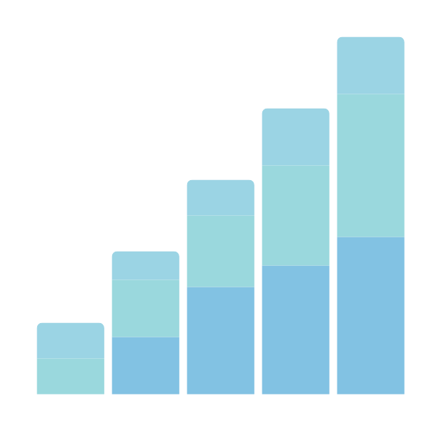
Dataset Narration
Datasets Used:
Contains country-wise demographic and economic data by region and income group.
Population data from 1960 to 2016.
GDP data from 1960 to 2016.
Key Features:
Country-wise population and GDP trends
Regional and income-based classification of countries
GDP per capita analysis
Literacy rates and health indicators (e.g., infant mortality)

Slide 4
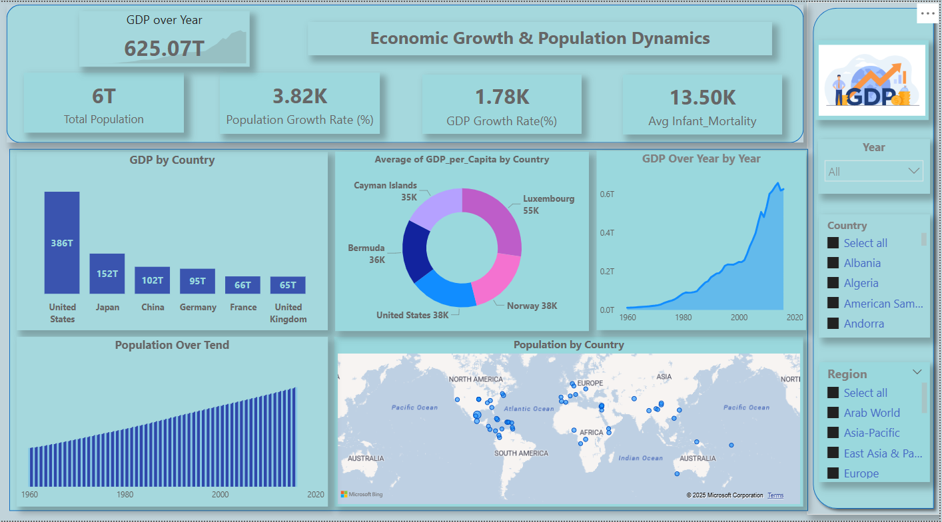

Slide 5
INSIGHTS
Population Growth
(1960 - 2016)
GDP per Capita Insights
Steady and linear growth from 61B (1960) to 158B (2020).
No major dips, indicating consistent birth rates
Driven by advancements in healthcare, agriculture, and living standards.
Causes: War (Yemen), weak infrastructure, poverty, and low industrialization.
Impact: Low wages, high unemployment, poor healthcare, and lower living standards.

Slide 6
INSIGHTS
Migration Rate
Sector
Highest Migration Rate: Countries like French Guiana, Hong Kong, and Belgium (above 44K) attract more migrants due to better job opportunities and economic stability.
Lowest Migration Rate: Micronesia (-21.0) and American Samoa (-20.7) face high emigration, likely due to economic challenges and limited opportunities.
Service Sector: Dominates with 118.08, driving the economy.
Industry Sector: At 59.04, half the size of services, indicating a service-driven economy.
Agriculture: Smallest at 31.36 (26.6%), reflecting a shift from farming to industry and services.

Slide 7

Recommendation’s
General:
Invest in education, technology, infrastructure, and
diverse sectors.
Enhance trade, FDI, and sustainable policies.
Country-Specific:
Zambia, Yemen: Diversify industries, invest in innovation.
Uzbekistan, Zimbabwe: Reform economy, improve
infrastructure & trade.
Overall: Attract FDI, boost education, and drive diversification.

Slide 8
Recommendation’s
Migration:
Low Migration Countries: Create jobs, improve infrastructure,
and enhance living conditions.
High Migration Countries: Manage population growth with
better housing and social services.
Economic Growth:
✔ Invest in industry & modern agriculture
✔ Strengthen the service sector with skills & technology
✔ Diversify through manufacturing, exports, & innovation

Slide 9

Thank you

